Slide 1
Lesson 23 – Integration Testing

Slide 2
Lesson Goals
Remember Testing Pyramid
Mockito
why we need too use it?
mock types
examples
Integration Testing
concept
Spring Boot Integration Testing

Slide 3
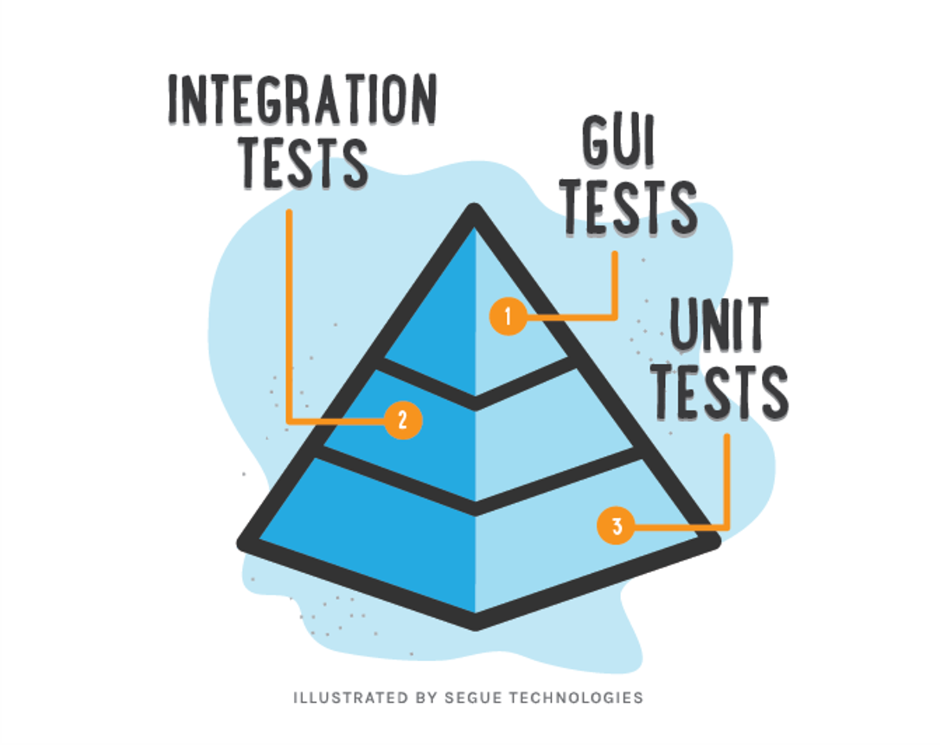
Testing levels aka “Testing Pyramid”
Manual Testing
$$$$
$

Slide 4
Mocking

Slide 5
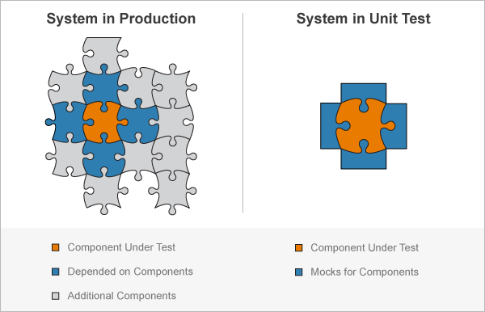
Mock Concept

Slide 6


Mocking libraries…

Slide 7
Mock Types
Stub – do nothing
Mock – perform mocked operations
Spy – real object with mocked operations

Slide 8
Example
🎹

Slide 9
Integration Testing Concept

Slide 10
Spring Boot Integration Testing
Spring Boot Testing deps
Layered testing:
DB layer
MockMvc layer
REST layer
Security tests

Slide 11
Example
🎹

Slide 12
Homework task
Cover existing fucntional by integration tests:
dontext dependent test
DB test
WebMvc test
Reach 100% coverage*

Slide 13
Literature
Baeldung + Keyword Search
https://docs.spring.io/spring-framework/docs/current/spring-framework-reference/testing.html#testing-introduction
https://docs.spring.io/spring-security/site/docs/current/reference/html5/#test-mockmvc

Slide 14

Thanks!
Any Questions?
Or find us in Slack:
@Yaroslav Brahinets
@Vasya Rudas
@Oleksandr Kucher

